Slide 1

Project 2 : Cellular response to drug perturbations
Ann- Sophie Kröll, Jana Braunger & Anna Münch
Supervisor: Nicolàs Palacio-Escat and Javier Perales-Patón
Tutor: Julia Rühle - 15.05.2019

Slide 2
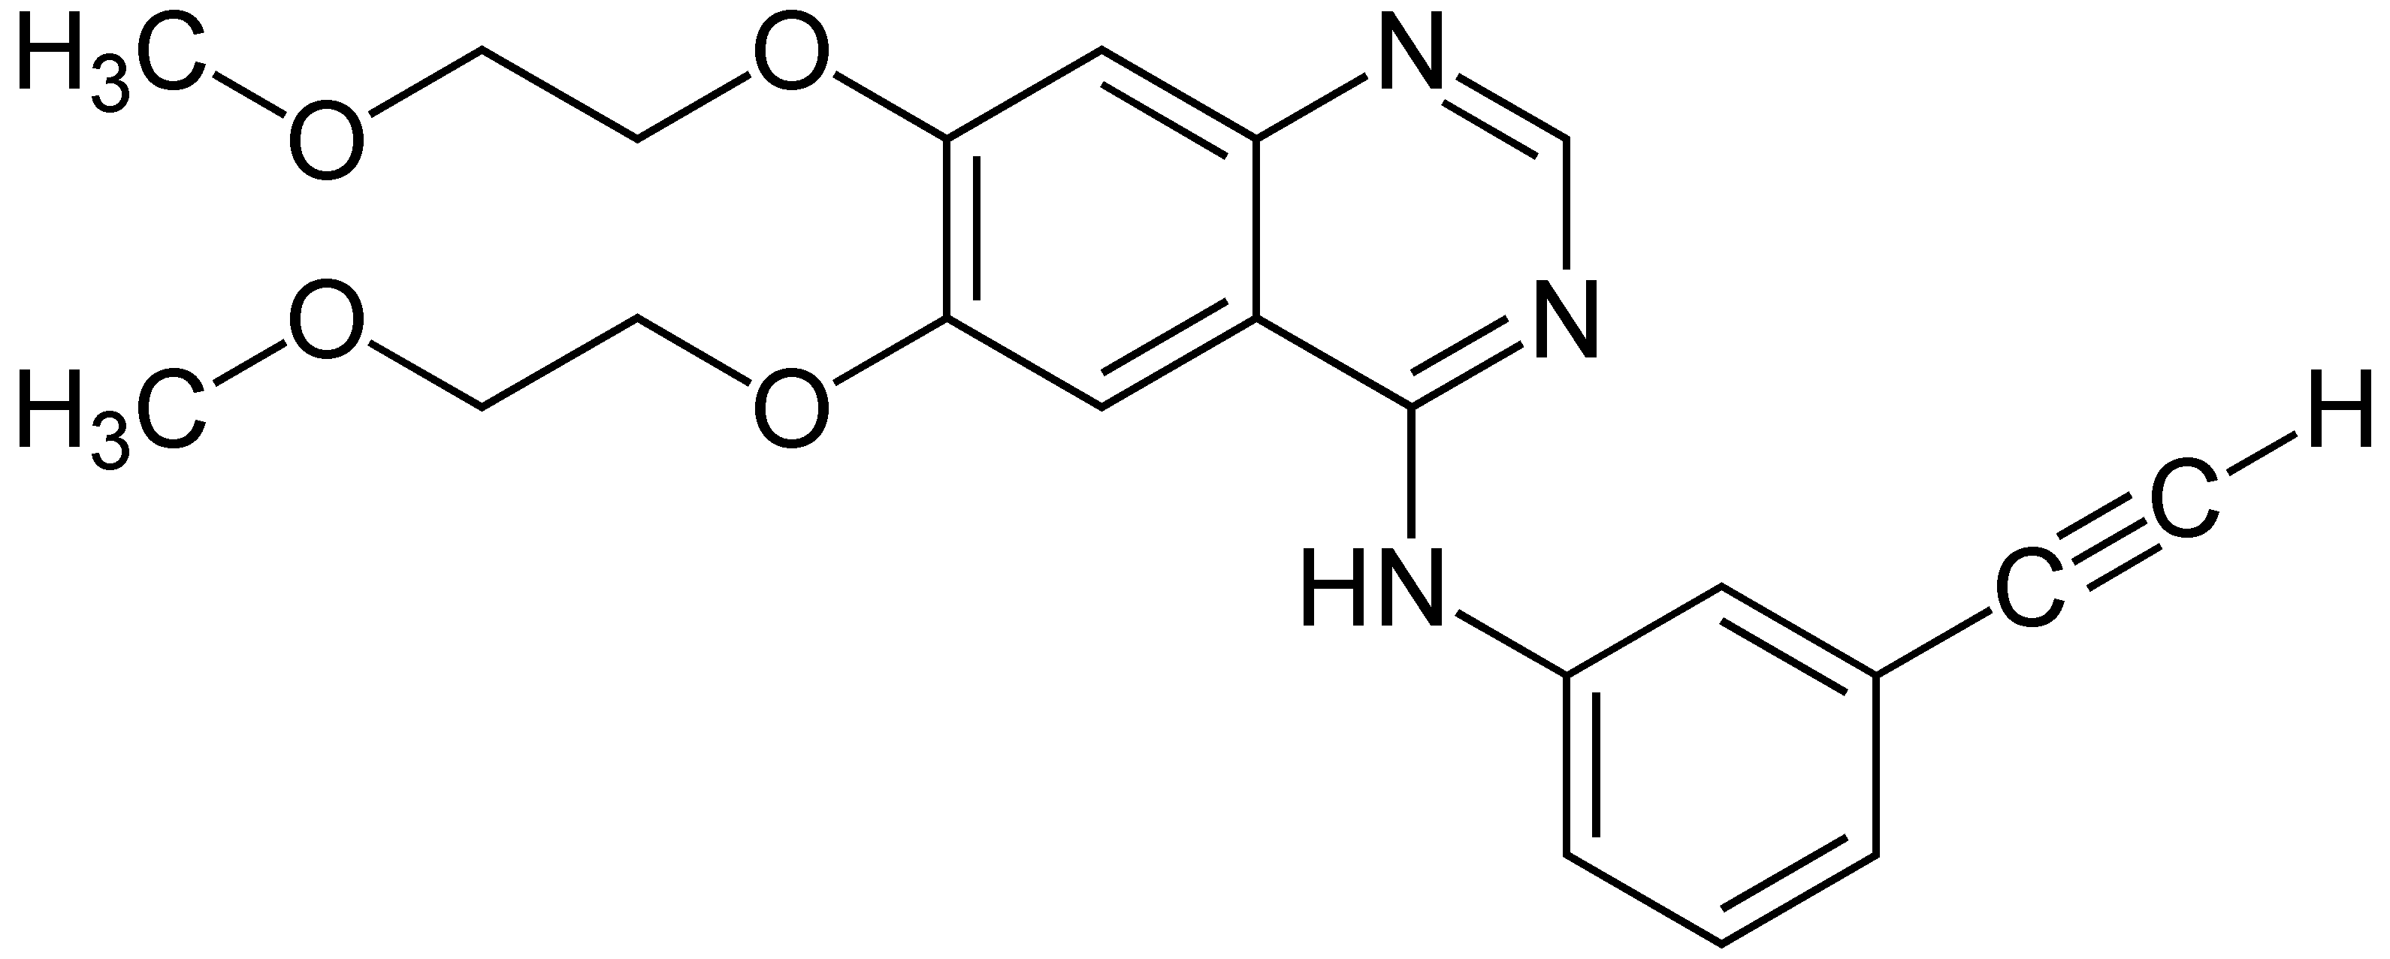
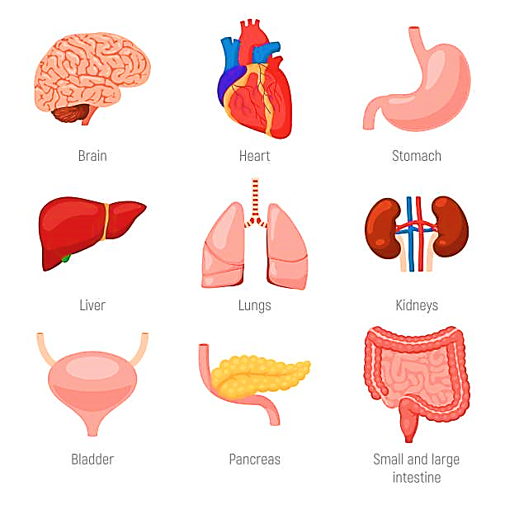
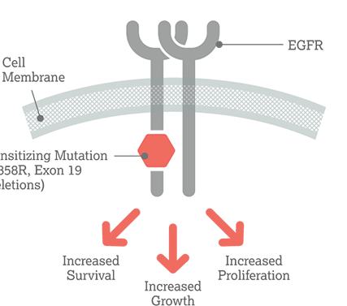

Erlotinib
Kinase inhibitor (EGFR, HER1 receptor)

Slide 3

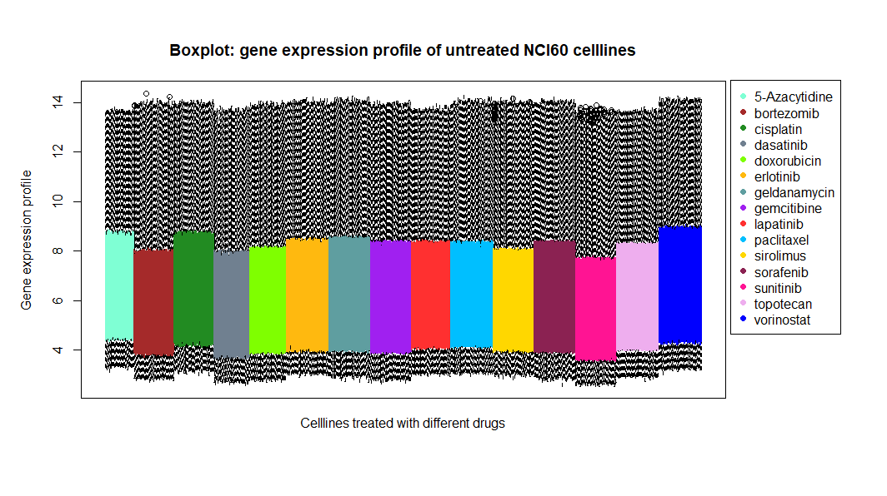
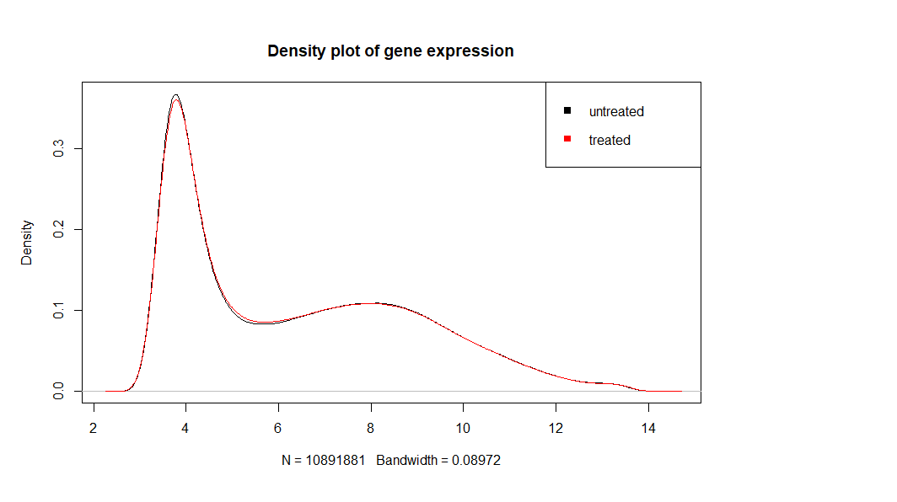
1. Milestone - Broad analysis
Expression profiles:
Boxplot
Density plot

Slide 4
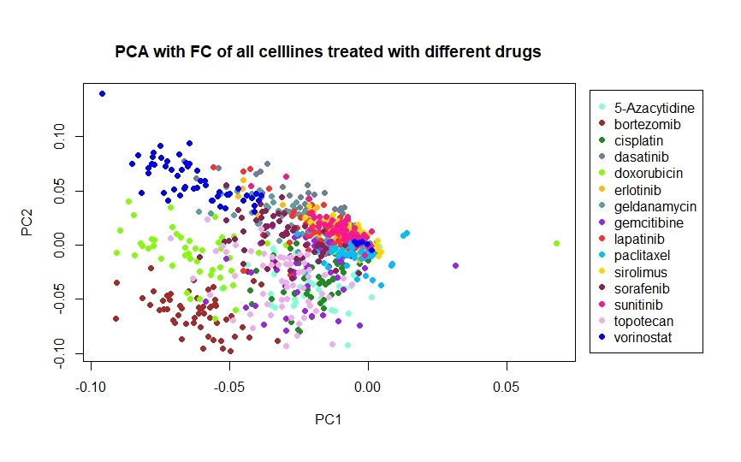
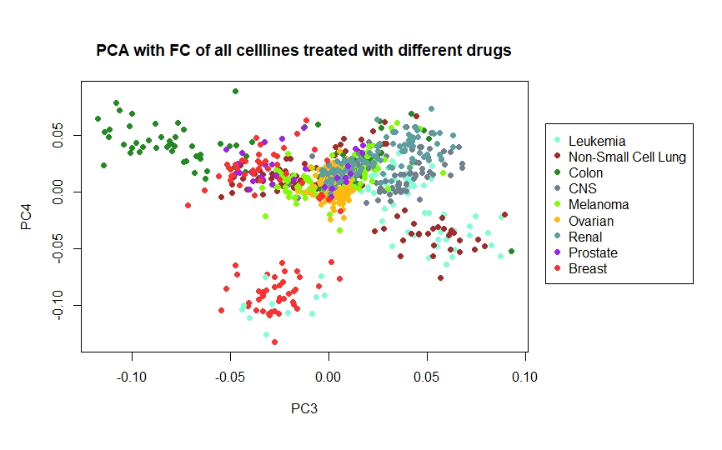
1. Milestone - Broad analysis
PCA

Slide 5
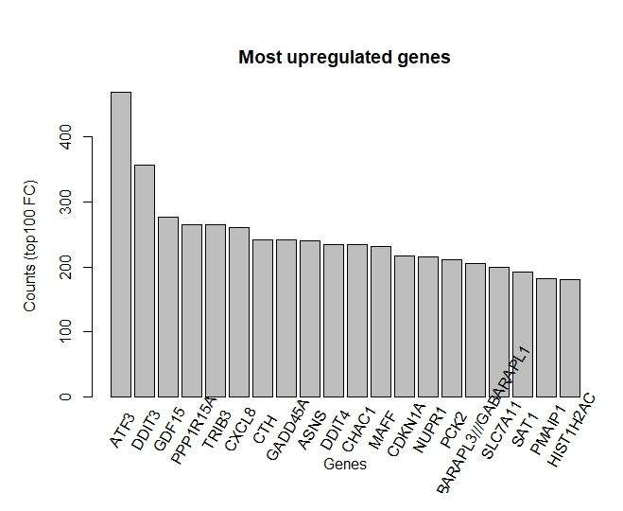
1. Milestone - Broad analysis
Biomarkers

Slide 6


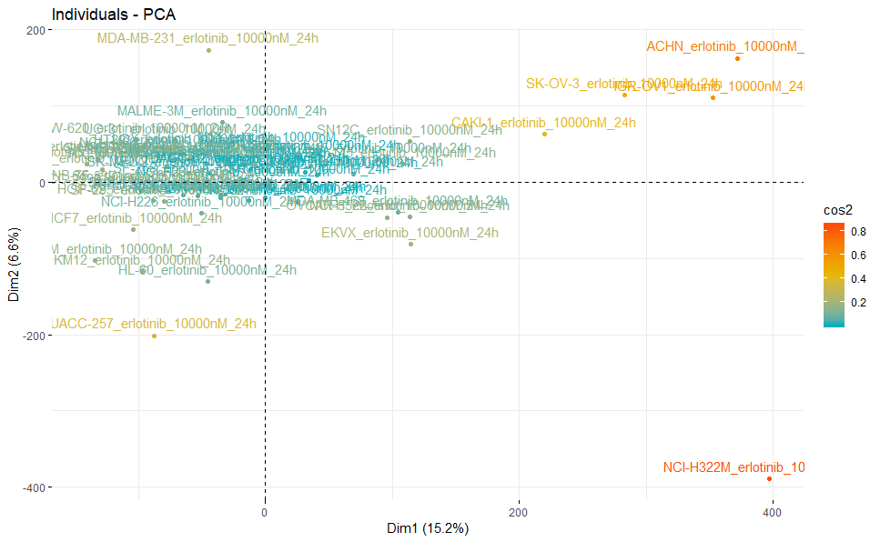
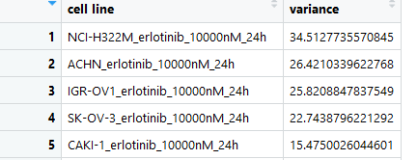
2. Milestone – Which genes and cell lines exposed the most change in regulation after Erlotinib treatment?
Cell Lines
Via PCA
Greatest variance in FC
Notes:
Differences between cell lines are more relevant to expression than drug treatment in PCA -> Treated (logarithmic data) - untreated (logarithmic data)
three most regulated genes
for 15 cell lines and colour the cancer type

Slide 7
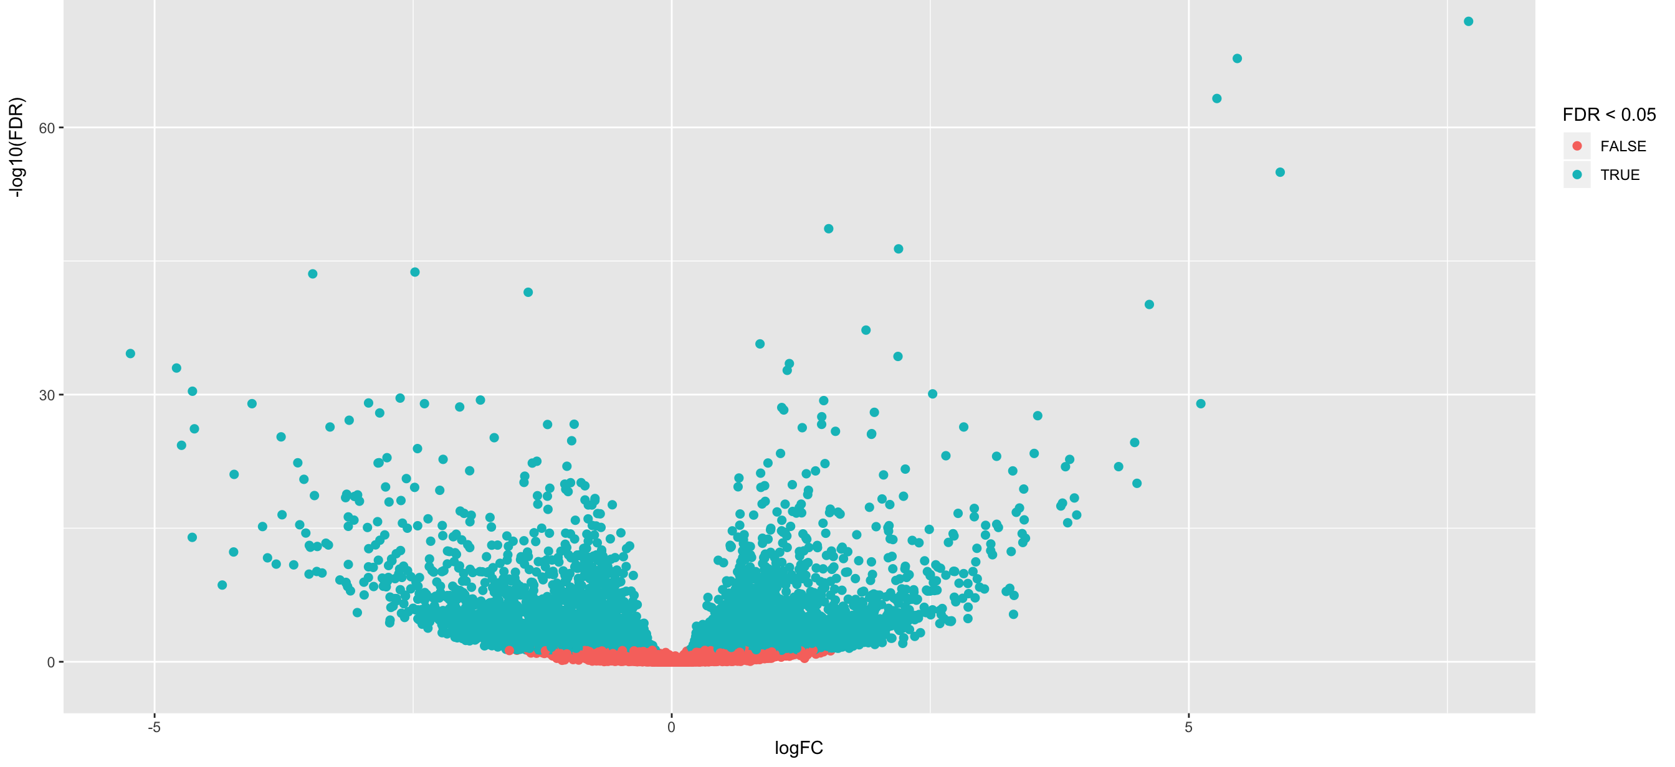
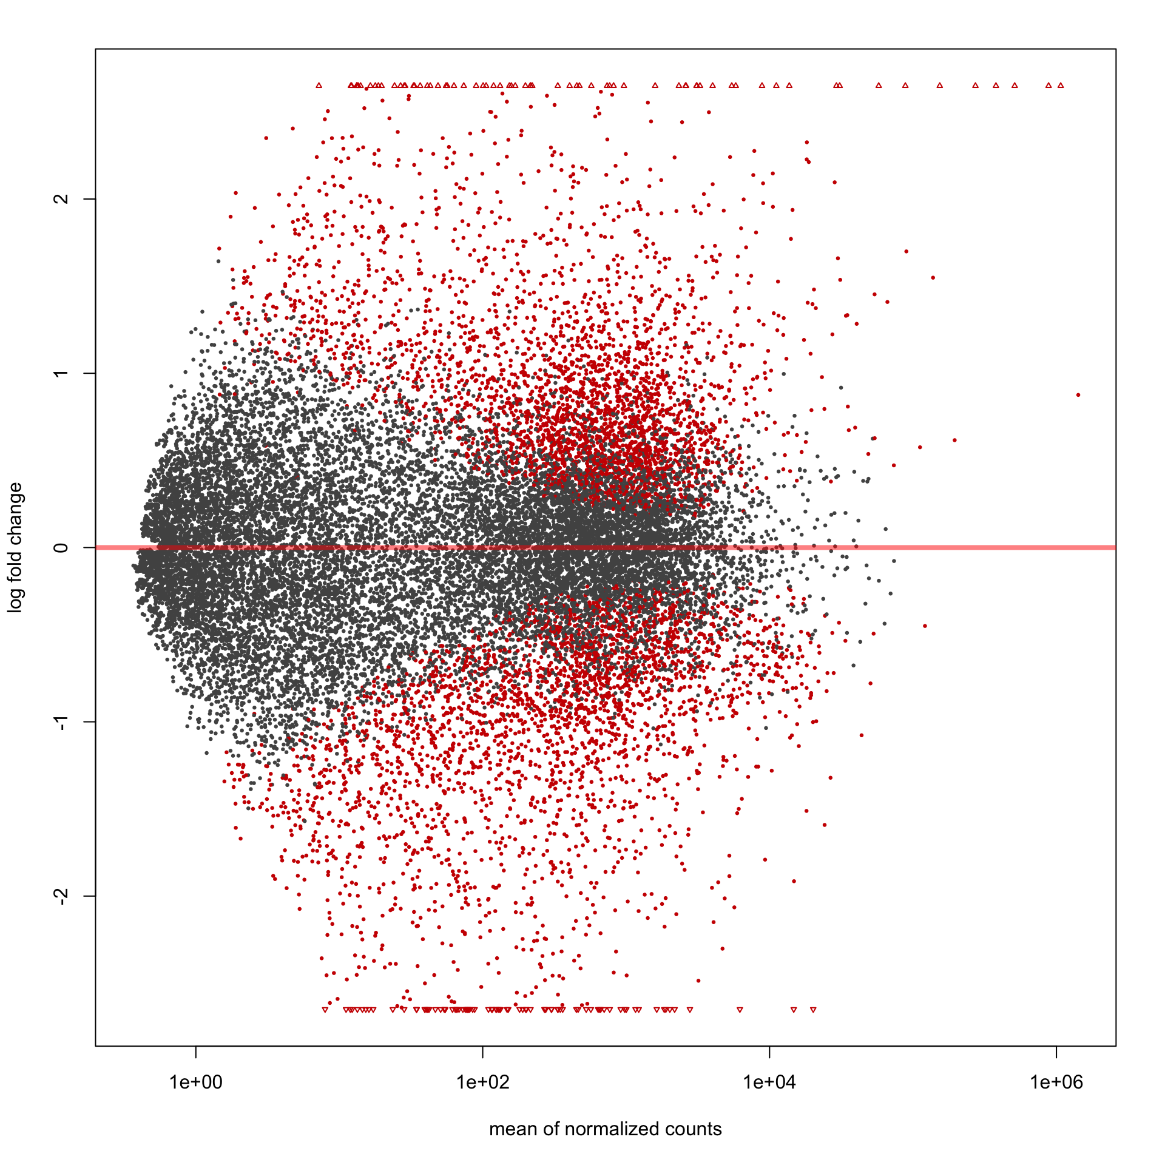
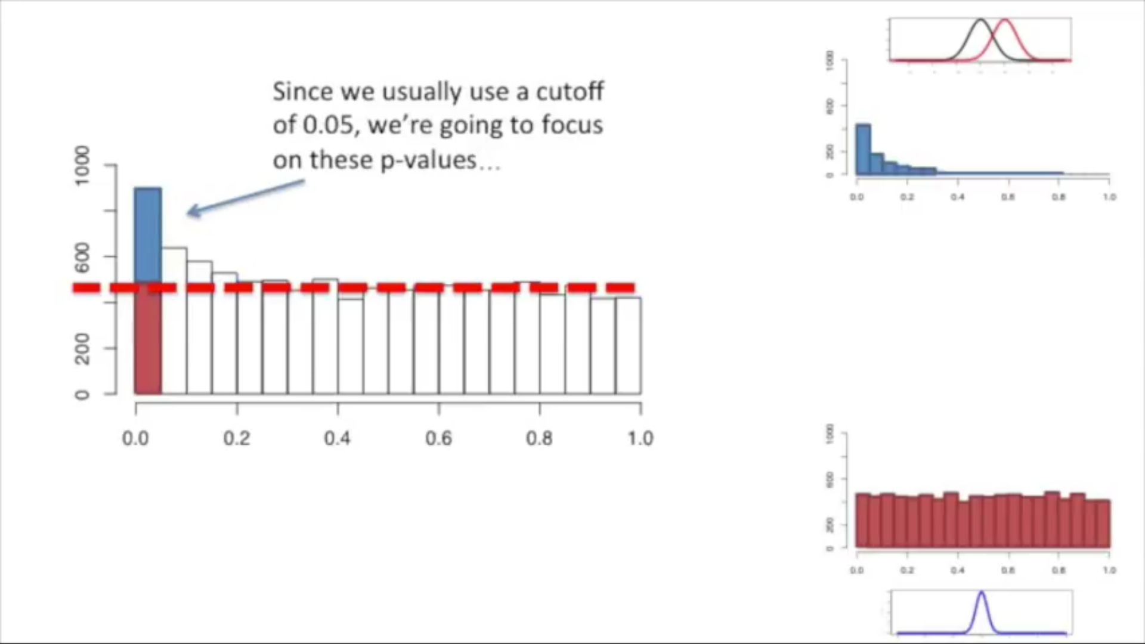
2. Milestone – Which genes and cell lines exposed the most change in regulation after Erlotinib treatment?
Volcano plot
(FC against FDR – t-test)
Genes
MA plot
H0 rejected
Blue: true positive
Red: false positive
H0 false
H0 true
Notes:
Differences between cell lines are more relevant to expression than drug treatment in PCA -> Treated (logarithmic data) - untreated (logarithmic data)
three most regulated genes
for 15 cell lines and colour the cancer type

Slide 8
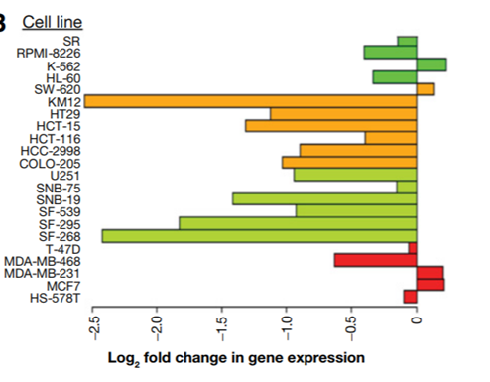
2. Milestone – Which genes and cell lines exposed the most change in regulation after Erlotinib treatment?
Genes
5
15 Cell Lines
Single gene response plot
Notes:
Differences between cell lines are more relevant to expression than drug treatment in PCA -> Treated (logarithmic data) - untreated (logarithmic data)
three most regulated genes
for 15 cell lines and colour the cancer type

Slide 9

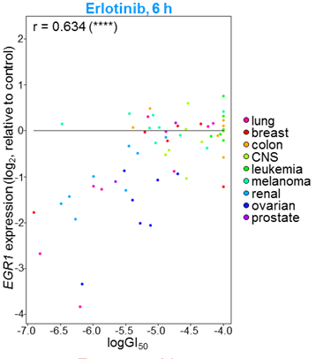
3. Milestone – Does the fold change correlate with cell growth inhibition?
Plot GI50 vs FC
Compare with 6h timepoint (Fig. S2)
linear regression
Pearson Correlation
Paired t-test
Wilcoxon signed rank test

Slide 10
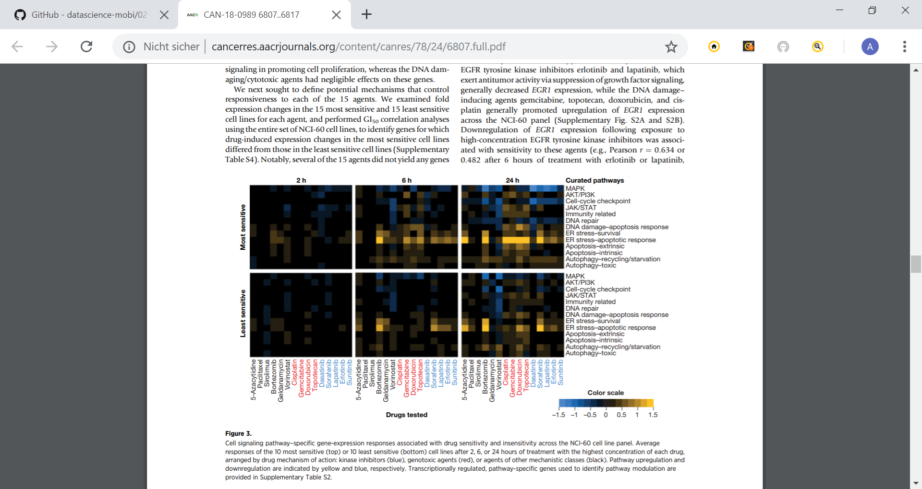
4. Milestone – Which cellular pathway’s are influenced by Erlotinib?
Affected cellular pathways
→ PROGENy or NCI
Heatmap: cell-lines vs. pathways
Comparison with other drugs
15 Cell lines

Slide 11
Time schedule
Broad Analysis
Influenced Cell Lines and Genes
Correlation with cell proliferation
Influenced Pathways
Interpreting results
Wed, 22.05.

Slide 12
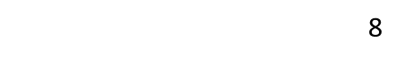
Time schedule
Broad Analysis
Influenced Cell Lines and genes
Correlation with cell proliferation
Influenced Pathways
Interpreting results
Wed, 05.06.

Slide 13
Time schedule
Broad Analysis
Influenced Cell Lines and Genes
Correlation with cell proliferation
Influenced Pathways
Interpreting results
Wed, 19.06.

Slide 14
Time schedule
Broad Analysis
Influenced Cell Lines and Genes
Correlation with cell proliferation
Influenced Pathways
Interpreting results
Wed, 03.07.

Slide 15
Broad Analysis
Influenced Cell Lines and Genes
Correlation with cell proliferation
Influenced Pathways
Interpreting results
Time schedule
Thank you for your attention!
Wed, 17.07.

Slide 16

Thank you for your attention!
?

Slide 17

NCI Transcriptional Pharmacodynamics Workbench
15 drugs → Erlotinib
2 concentrations ( c_{max} , GI₅₀)
12,704 genes
NCI-60-Cell line
Comparison untreated and treated transcriptional expression

Slide 18

Data sets
Name | Discription | Transformations | Data Type
NCI_TPW_gep_treated/ untreated | Gene expression profiles Rows: genes Columns: samples | Log₂ transformed | Matrix
NCI_treated_metadata | Metadata from expressionprofiles |  | Dataframe
NeglogGI50 | Drug sensitivity profile (50% growth inhibition) Rows: drug Columns: cancer cell lines | -log₁₀ transformed | Matrix
CCLE_mutations | Somatic mutations of cancer cell lines |  | Dataframe
CCLE_copynumbers | Gene copy number atteations | Log₂ transformed | dataframe
CCLE_basalexpression | Basal gen expression of cell lines | Log₂ transformed | Dataframe
Cellline_annotation | Type, Doubling Time, Mutationrate, Microsatellite instability |  | Dataframe
Drug_annotation | mean GI50 (µM), Mechanism, clinical phase, target, disease area |  | Dataframe

Slide 19
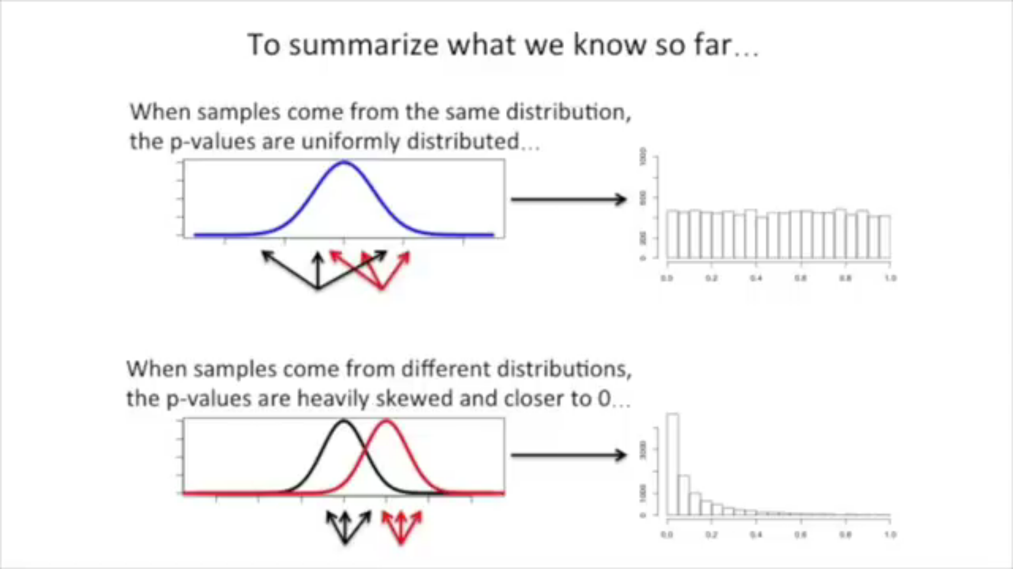
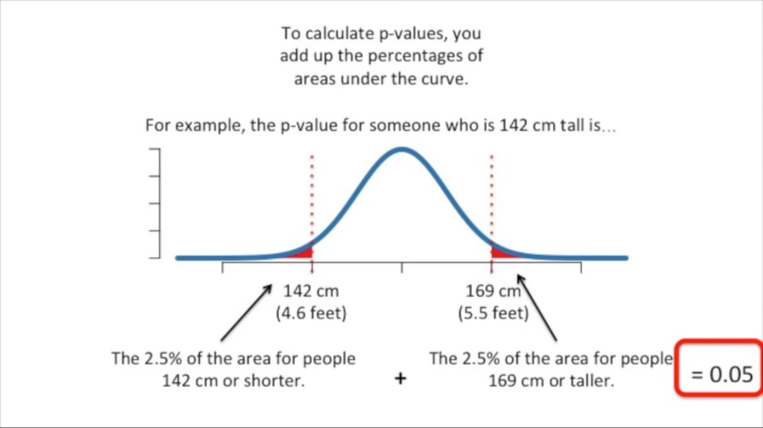
P-Value
A p-value is the probability that random chance generated the data, or something else is equal or rarer

Slide 20
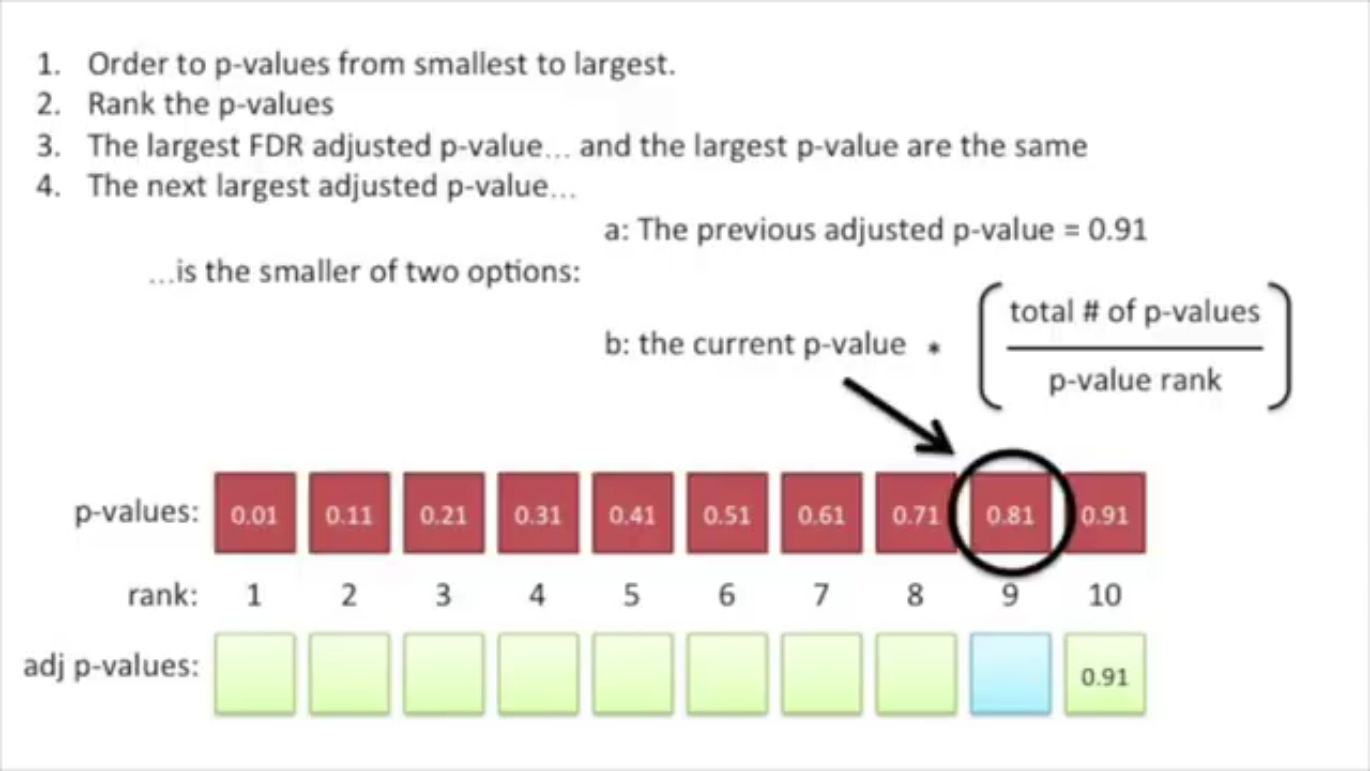
FDR

